Slide 1


Machine Learning and NLP: A Comparative Study DSA0306 -Natural Language Processing
Presented by:
Vimala K (192424276)
Guided by:
Dr. T. KUMARAGURUBARAN

Slide 2
Definition
Machine Learning (ML)
A branch of Artificial Intelligence (AI).
Enables computers to learn from data without being explicitly programmed.
Improves performance by learning patterns.
Example:
Predicting whether an email is Spam or Not Spam based on previous email data.
Natural Language Processing (NLP)
A branch of AI that enables computers to understand, process, and generate human language.
Focuses on text and speech data.
Example:
Google Translate converting English to Tamil.

Slide 3
Primary Goal
Machine Learning | NLP
Learn patterns from data.
Predict future outcomes.
Classify data.

Slide 4
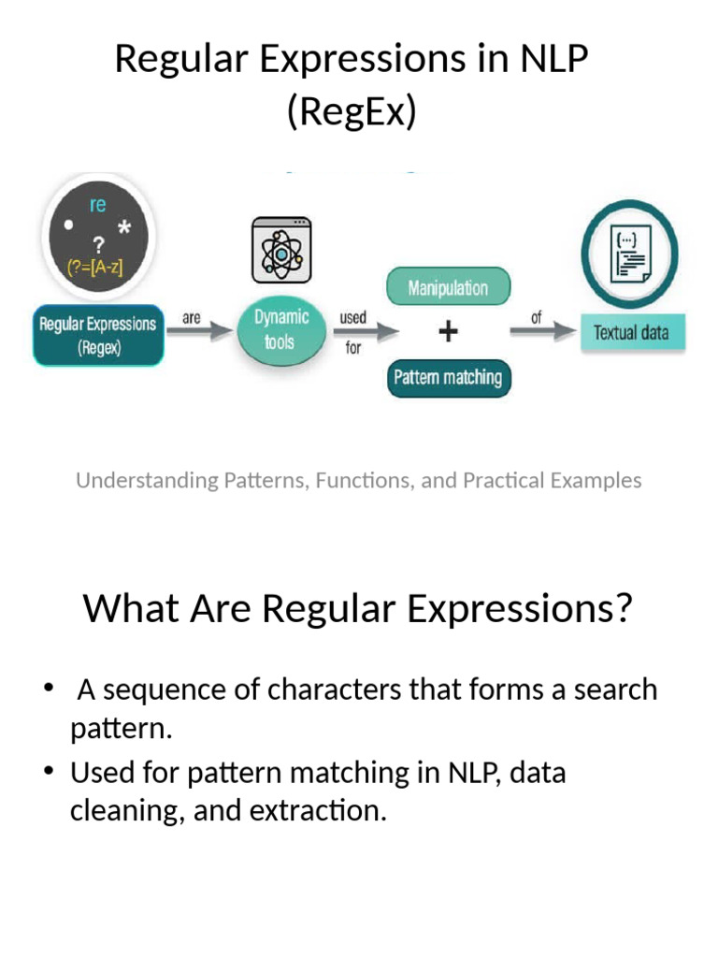
Introduction
A Regular Expression (RE) is a sequence of characters used to define a search pattern.
It is used for text pattern matching, validation, and information extraction.
Regular expressions help computers identify specific text patterns in large datasets.
Widely used in NLP, text processing, search engines, and data validation.

Slide 5
Applications
Text preprocessing
Data cleaning
Tokenization
Pattern matching
Information extraction
Email and phone number validation
Date and URL extraction
Spam filtering
Chatbots
Search engines

Slide 6
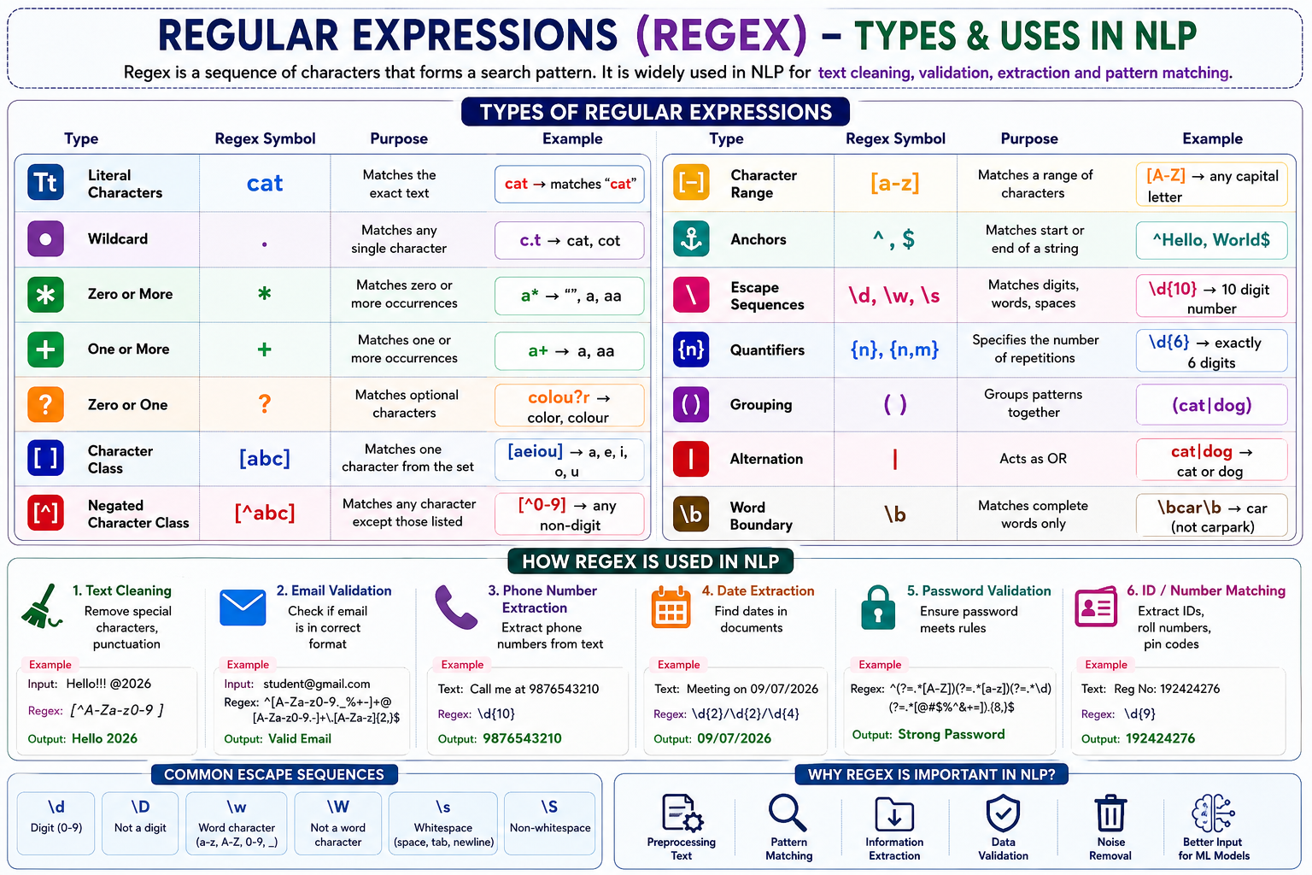

Slide 8
Thank You

